Slide 1
PROBABILITY & STATISTICS
Chapter 9: Tests of Hypotheses for a Single Sample
LEARNING OBJECTIVES
1. Introduction
2. Test on the μ of NORMDIST
σ² known
σ² unknown
3. Test on the p: Large-sample

Slide 2
STATISTICAL HYPOTHESES
Introduction
Definition Statistical Hypotheses
A statistical hypothesis is a statement about the
parameters of one or more populations.
Example
Suppose that we are interested in the burning rate of a solid propellant used to power aircrew escape systems.
Burning rate is a random variable
We are interested in deciding whether or not the mean burning rate is 50 centimeters per second.

Slide 3
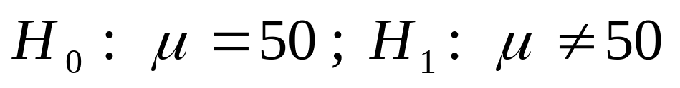
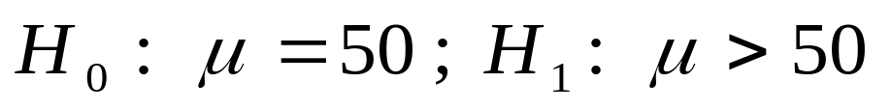
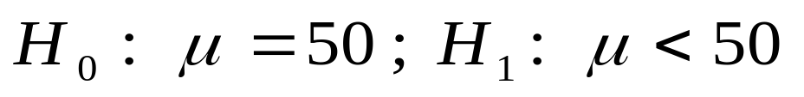
STATISTICAL HYPOTHESES
Introduction
Two-sided Alternative Hypothesis
Null hypothesis
Alternative hypothesis
One-sided Alternative Hypotheses

Slide 4
STATISTICAL HYPOTHESES
Introduction
Test of a Hypothesis
A procedure leading to a decision about a particular hypothesis
Hypothesis-testing procedures rely on using the information in a random sample from the population of interest.
If this information is consistent with the hypothesis, then we will conclude that the hypothesis is true; if this information is inconsistent with the hypothesis, we will conclude that the hypothesis is false.

Slide 5
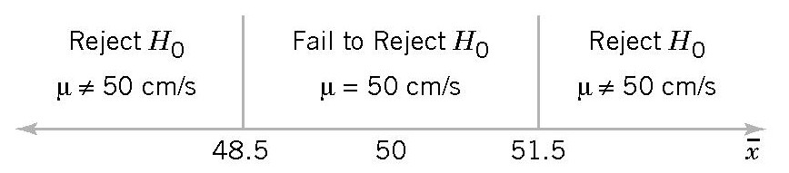
STATISTICAL HYPOTHESES
Introduction
Example 1
Decision criteria for testing H₀: μ = 50; H₁: μ ≠ 50

Slide 6
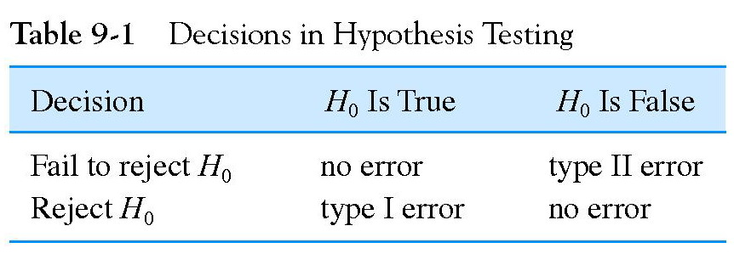
ERRORS
Introduction
α = P( type I error ) = P( reject H₀ when H₀ is true )
Significance level
β = P( type II error) =P( fail to reject H₀ when H₀ is false)

Slide 7
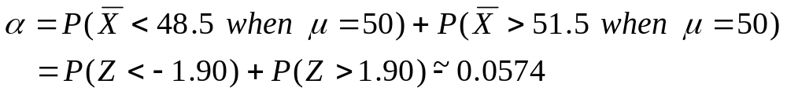
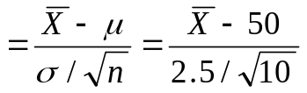
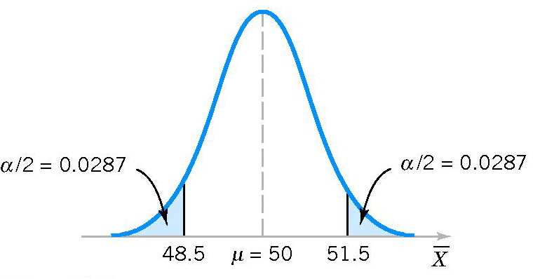
ERRORS
Introduction
To calculate α, we assume that σ = 2.5 and n = 10.

Slide 8
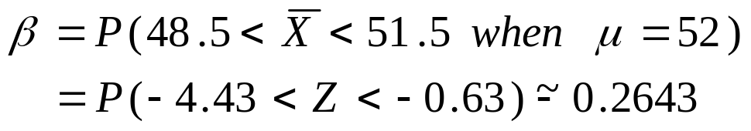
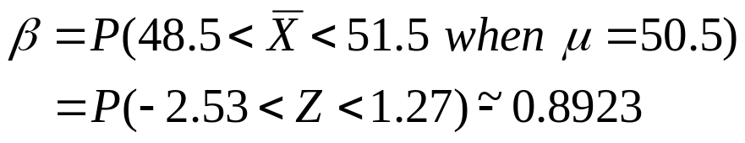
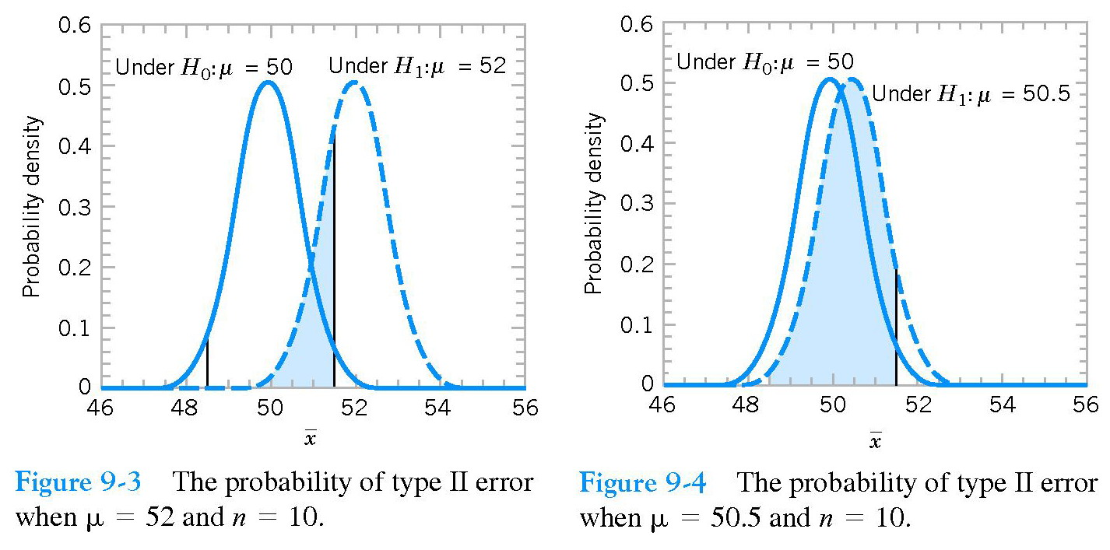
ERRORS
Introduction

Slide 9
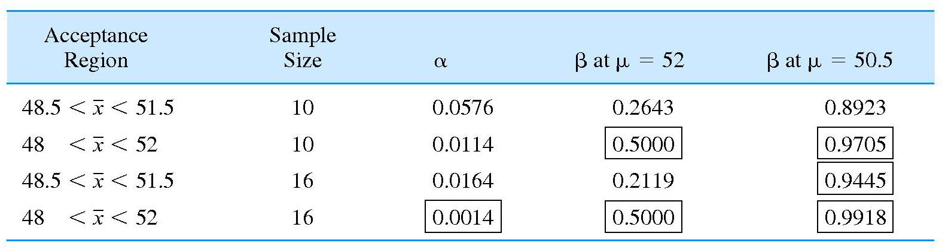
ERRORS
Introduction

Slide 10
ERRORS
Introduction
The size of the critical region, and consequently the probability of a type I error , can always be reduced by appropriate selection of the critical values.
Type I and type II errors are related: β ↓ then α ↑ and α ↓ then β ↑ , provided that n fix.
An increase in sample size will generally reduce both α and β, provided that the critical values are held constant.
When the null H₀ is false, β ↑ as the true value of the parameter approaches the value hypothesized in H₀,β ↓ as the difference between the true mean and the hypothesized value increases.

Slide 11
POWER OF A TESTING
Introduction
Definition power of a statistical test
The power of a statistical test is the probability of rejecting the null hypothesis H₀ when the alternative hypothesis is true.
The power is computed as 1 - b, and power can be interpreted as the probability of correctly rejecting a false null hypothesis.
We often compare statistical tests by comparing their power properties.

Slide 12
TEST ON THE μ OF NORMDIST: σ² KNOWN
Hypothesis-testing problems
Two-sided test: H₀: µ = µ₀; H₁: µ ≠ µ₀
σ² known
One-sided test: H₀: µ = µ₀; H₁: µ > µ₀
H₀: µ = µ₀; H₁: µ < µ₀

Slide 13
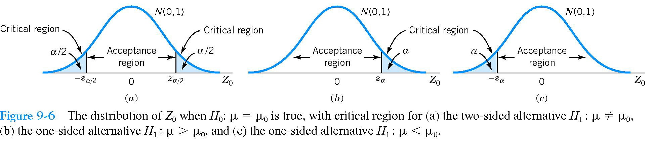
TEST ON THE μ OF NORMDIST: σ² KNOWN
σ² known

Slide 14
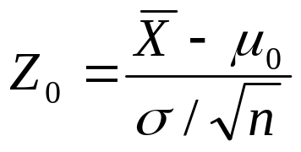
TEST ON THE μ OF NORMDIST: σ² KNOWN
Hypothesis Tests on the Mean z-test
Null hypothesis: H₀: μ = μ₀
Test statistic:
Alternative hypothesis Rejection criteria
H₁: μ ≠ μ₀ |z₀|> z_{α/2}
H₁: μ > μ₀ z₀ > z_{α}
H₁: μ < μ₀ z₀ < - z_{α}
σ² known

Slide 15

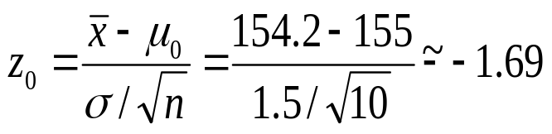
TEST ON THE μ OF NORMDIST: σ² KNOWN
Example 2
A melting point test of n = 10 samples of a binder used in manufacturing a rocket propellant resulted in = 154.2⁰ . Assume that melting point is normally distributed with σ = 1.5⁰.
Test H₀: μ = 155; H₁: μ ≠ 155 using α = 0.05.
Solution: Test statistic:
z_{α/2} = z_{0.025} = 1.96.
| z₀ | < z_{α/2}.
Fail to reject H₀ at α = 0.05
σ² known

Slide 16
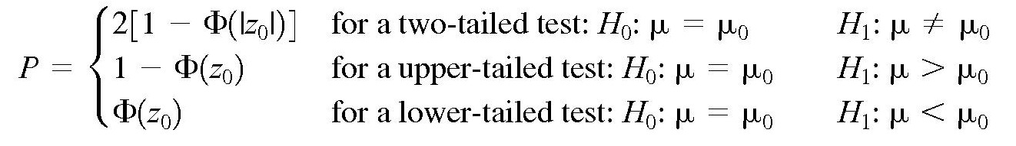
TEST ON THE μ OF NORMDIST: σ² KNOWN
P-Values in Hypothesis Tests
Definition
σ² known
The P-value is the smallest level of significance that would lead to rejection of the null hypothesis H₀ with the given data.

Slide 17
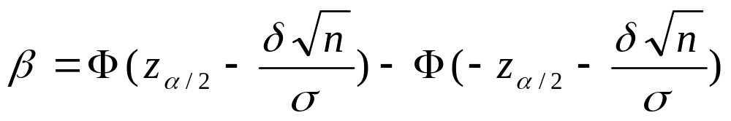
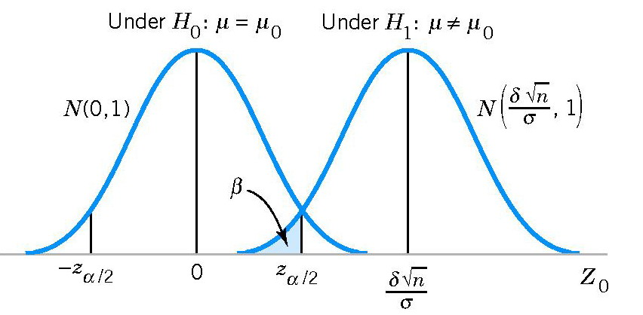
TEST ON THE μ OF NORMDIST: σ² KNOWN
Type II Error and Choice of Sample Size
Probability of type II error β for a two-sided test
σ² known
where δ = μ – μ₀

Slide 18
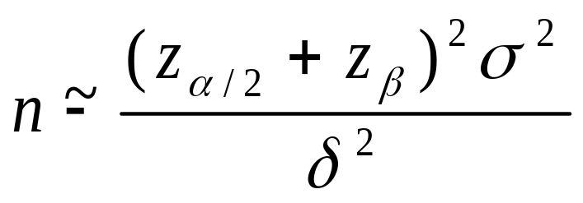
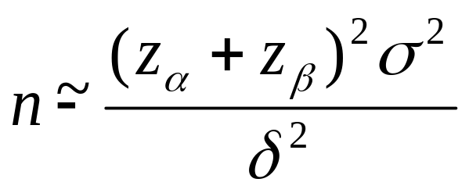
TEST ON THE μ OF NORMDIST: σ² KNOWN
Type II Error and Choice of Sample Size
Sample Size Formulas
σ² known
Two-sided test
One-sided test
where δ = μ – μ₀.

Slide 19
TEST ON THE μ OF NORMDIST: σ² KNOWN
Exercise
The life in hours of a battery is known to be approximately normally distributed, with standard deviation σ =1.25 hours. A random sample of 10 batteries has a mean life of =40.5 hours.
Is there evidence to support the claim that battery life exceeds 40 hours? Use α = 0.05.
(b) What is the P-value for the test in part (a)?
(c) What is the β-error for the test in part (a) if the true mean life is 42 hours?
(d) What sample size would be required to ensure that does not exceed 0.10 if the true mean life is 44 hours?
σ² known

Slide 20
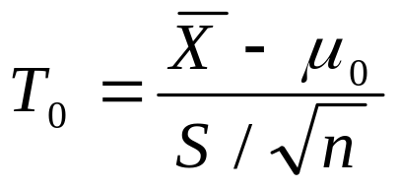
TEST ON THE μ OF NORMDIST: σ² UNKNOWN
Hypothesis Tests on the Mean t-test
Null hypothesis: H₀: μ = μ₀
Test statistic:
Alternative hypothesis Rejection criteria
H₁: μ ≠ μ₀ |t₀|> t_{α/2, n-1}
H₁: μ > μ₀ t₀ > t_{α, n-1}
H₁: μ < μ₀ t₀ < - t_{α, n-1}
σ² unknown

Slide 21
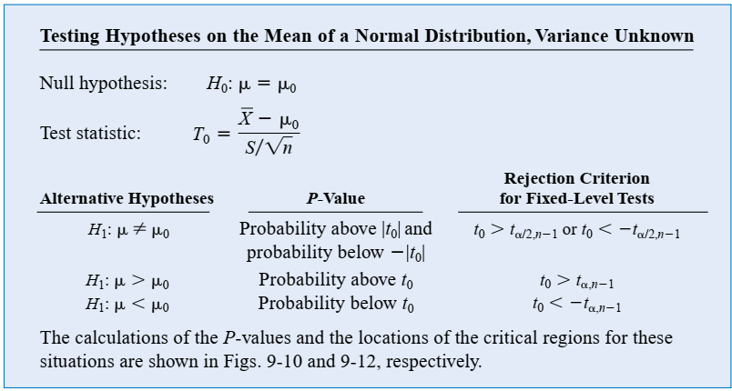
TEST ON THE μ OF NORMDIST: σ² UNKNOWN
Hypothesis Tests on the Mean t-test
σ² unknown

Slide 22
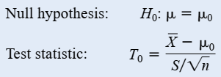





TEST ON THE μ OF NORMDIST: σ² UNKNOWN
Hypothesis Tests on the Mean P- Value
σ² unknown

Slide 23
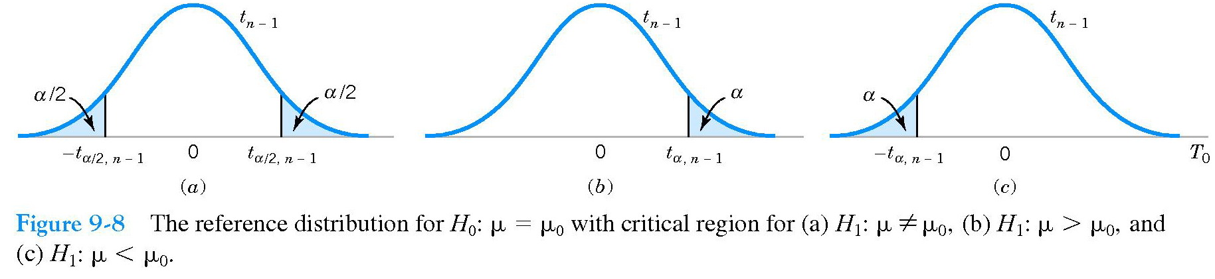
TEST ON THE μ OF NORMDIST: σ² UNKNOWN
σ² unknown

Slide 24
TEST ON THE μ OF NORMDIST: σ² UNKNOWN
Exercise
Consider the dissolved oxygen concentration at TVA dams. The observations are (in milligrams per liter): 5.0, 3.4, 3.9, 1.3, 0.2, 0.9, 2.7, 3.7, 3.8, 4.1, 1.0, 1.0, 0.8, 0.4, 3.8, 4.5, 5.3, 6.1, 6.9, and 6.5.
Test the hypotheses H₀: µ = 4; H₁: µ ≠ 4. Use α = 0.01.
(b) What is the P-value in part (a)?
(c) Compute the power of the test if the true mean µ = 3.
σ² unknown

Slide 25
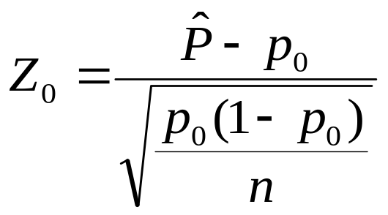
TEST ON THE p: LARGE-SAMPLE
Hypothesis Tests on the Mean
Null hypothesis: H₀: p = p₀
Test statistic:
Alternative hypothesis Rejection criteria
H₁: p ≠ p₀ |z₀|> z_{α/2}
H₁: p > p₀ z₀ > z_{α}
H₁: p < p₀ z₀ < - z_{α}
Test on the p

Slide 26
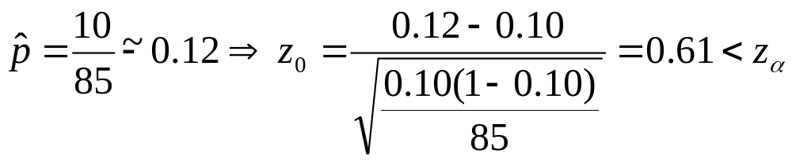
TEST ON THE p: LARGE-SAMPLE
Example
In a random sample of 85 automobile engine crankshaft bearings, 10 have a surface finish roughness that exceeds the specifications. Does this data present strong evidence that the proportion of crankshaft bearings exhibiting excess surface roughness exceeds 0.10? State and test the appropriate hypotheses using α = 0.05.
Test on the p
=1.65
Solution: H₀: p = 0.10; H₁: p > 0.10
Fail to reject H₀ at α = 0.05.

Slide 27
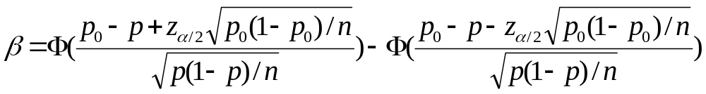
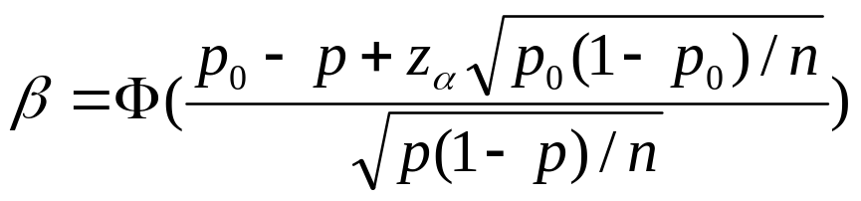
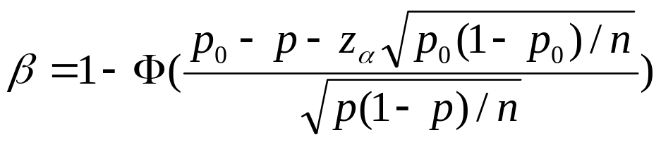
TEST ON THE p: LARGE-SAMPLE
Type II Error and Choice of Sample Size
Probability of type II error β
Two-sided test
One-sided test: p > p₀
One-sided test: p < p₀
Test on the p

Slide 28
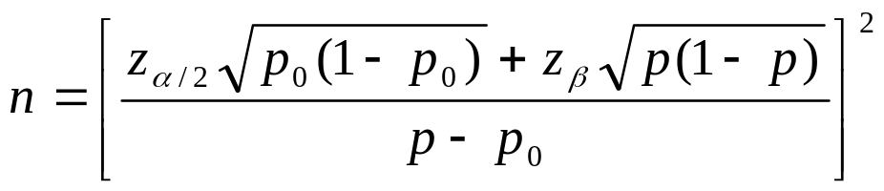
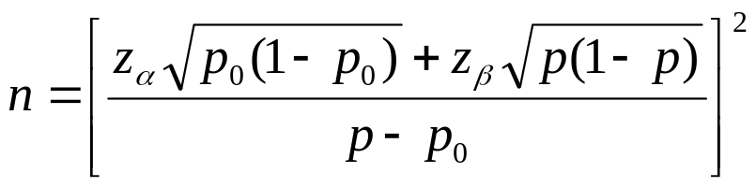
TEST ON THE p: LARGE-SAMPLE
Type II Error and Choice of Sample Size
Sample Size Formulas
Two-sided test
One-sided test
Test on the p

Slide 29
SUMMARY
We have studied:
1. Test on the μ of NORMDIST
σ² known
σ² unknown
2. Test on the p: Large-sample
Summary
Homework: Read slides of the next lecture.

